Slide 1

Web Scraping

Slide 2
Motivation for Web Scraping
Relying on Downloadable CSV’s Puts You at a Disadvantage
Majority of Data Is Found Online
Negative: Online Data is Unstructured in HTML Format
Positive: Online Data is Often Updated, Relevant, & Untapped

Slide 3
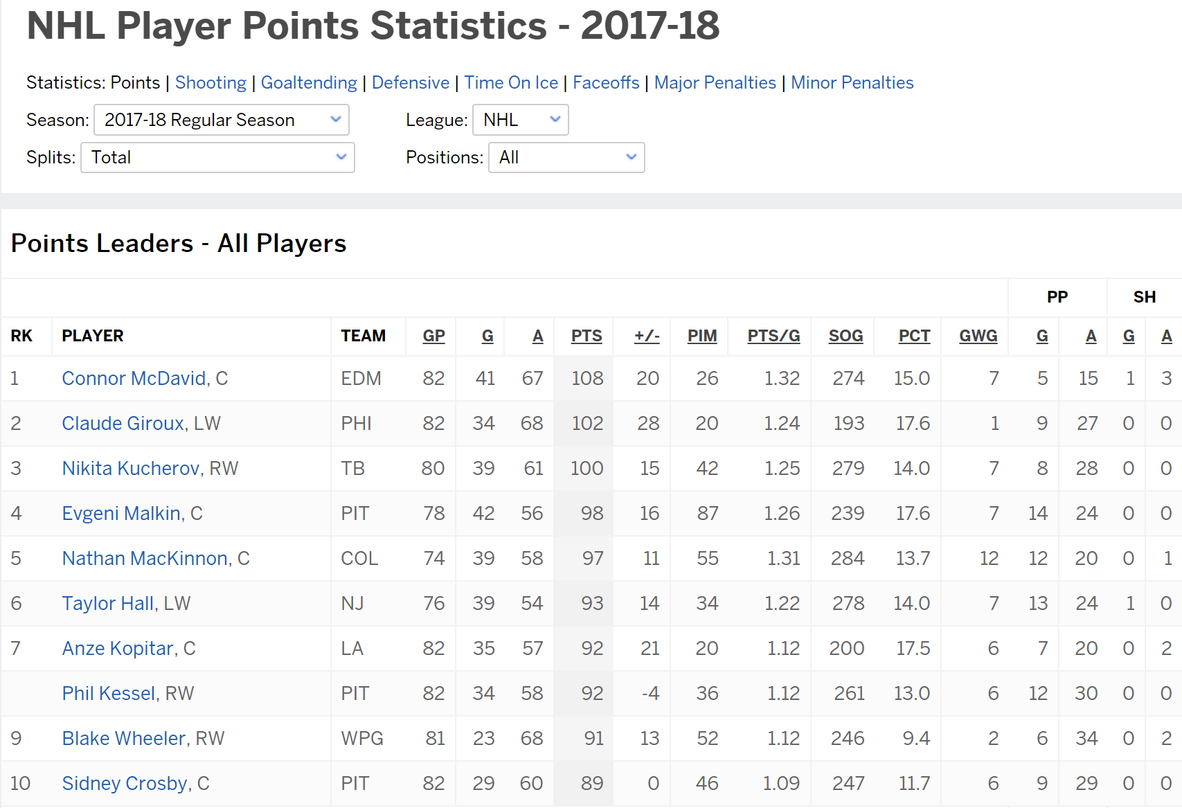
Motivation for Web Scraping
Example 1: ESPN NHL Stats

Slide 4
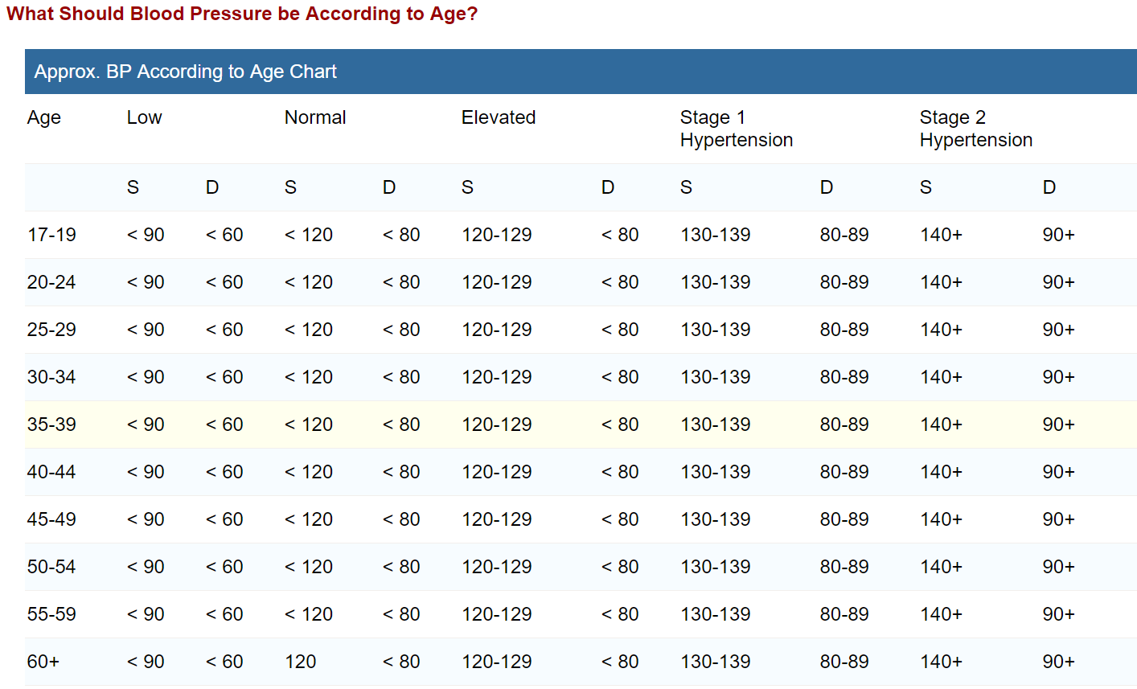
Motivation for Web Scraping
Example 2: Blood Pressure Chart

Slide 5
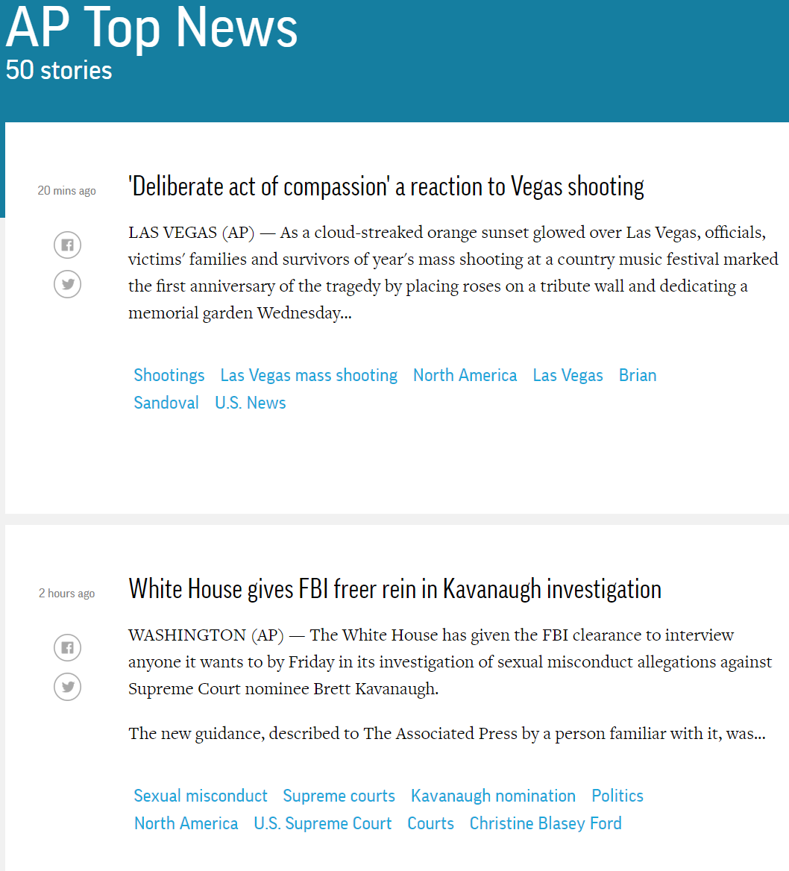
Motivation for Web Scraping
Example 3: AP Top 50 Stories

Slide 6
Web Scraping Defined
Process of Converting Currently Unstructured Data on Web to Structured Data in R
Ideas:
ESPN Table to CSV
Blood Pressure Chart to Tibble
Top News Stories to List in R
Absolutely Crucial Skill for Modern Data Scientists

Slide 7
Web Scraping in R
The rvest package
Written by Hadley Wickham
General Process:
> library(rvest)
Parse HTML
Extract Pieces You Want
Clean Information
URL

Slide 8
Supplement Introduction
Step 1: Open Supplement
Step 2: Ensure You Have the Following R Packages Installed
tidyverse
rvest (Requires Internet)
devtools
noncensus (Install from Github)
Step 3: Knit and Run
Step 4: Read the Introduction

Slide 9
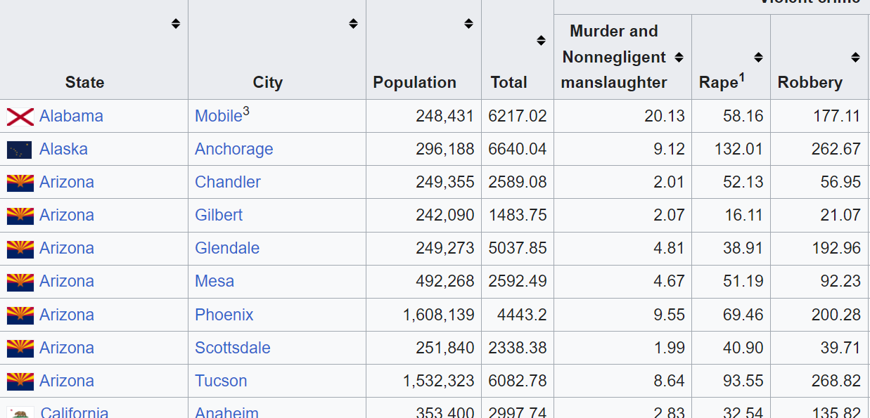
Part 1: Violent Crimes in US Cities
Step 1: Wikipedia Violent Crimes
Step 2: Locate the Table
Goal: Read Table Into R

Slide 10
Part 1: Violent Crimes in US Cities
Step 3: What Do You Expect to Be a Problem in the Data?
Step 4: Run Chunk 1
Is This What You Expected?
What New Problems Arise?
Step 5: Run Chunk 2
Select Wanted Information
Remove 1st and 2nd Rows
Rename Variables

Slide 11
Part 1: Violent Crimes in US Cities
Step 6: Run Chunk 3
Converting Variable Types
as.numeric()
as.character()
as.date()
as.integer()
All Numeric Variables are Character Because of First Row
Step 7: Run Chunk 4
City Variable Has Problems
State Variable Has Problems
Why Do We Care?

Slide 12
Part 1: Violent Crimes in US Cities
Step 8: Run Chunk 5
String Functions Used
str_replace_all()
str_replace()
Conditional Mutation
ifelse()
Step 9: Base Knit

Slide 13
Part 2: Geographical Locations of US Cities
Step 1: What Additional Information Would We Need to Plot Crime Information on a Map?
Step 2: Run Chunk 1
What Info is Important?
What Do You Notice About the City Variable?
Step 3: Run Chunk 2
Goal: Find the Average Latitude and Longitude for Each City and State

Slide 14
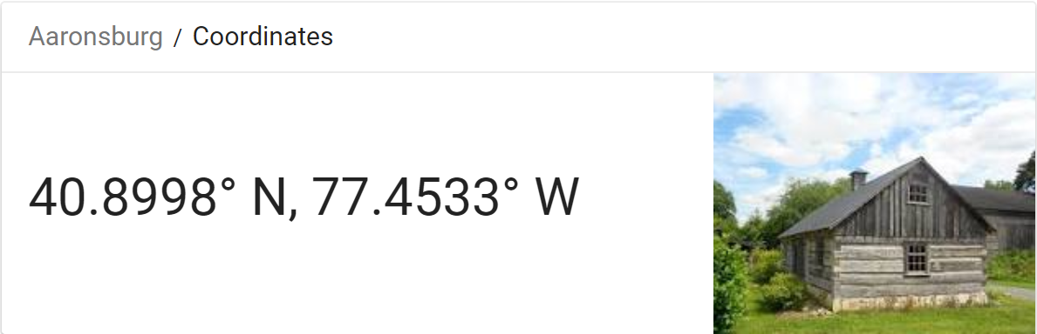
Part 2: Geographical Locations of US Cities
Step 4: Run Chunk 3
Examine the Output
Notice Aaronsburg, PA
Are We Ready to Merge?
#No
#WhyNot
Step 5: Pinch Knit

Slide 15
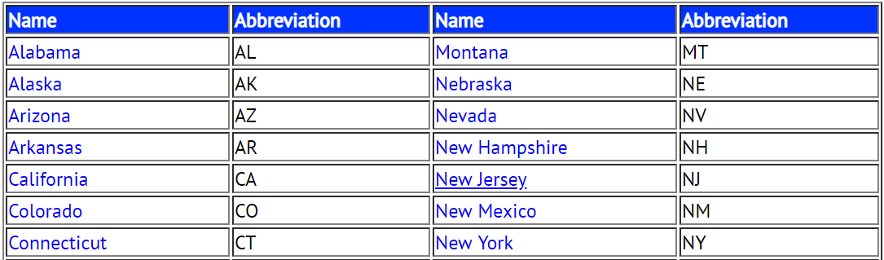
Part 3: Linking State Names to State Abbreviations
Step 1: Select Website Link
Step 2: Examine the Table
Step 3: What is the Issue with the Way this Information is Presented and How Does this Pose a Threat to Our Existence?

Slide 16
Part 3: Linking State Names to State Abbreviations
Step 4: Run Chunk 1
Did You Get What You Expected?
How Should We Fix This Data?
Step 5: Run Chunk 2
Stacking Datasets
Horizontally
Vertically
Step 6: Knitting Streak
> cbind(x,y)
> rbind(x,y)

Slide 17
Part 4: Inclusion of Expert Opinion
Step 1: Selector Gadget Website
Open Source
Chrome Extension Exists
Easy: Drag Link to Bookmark Bar as Webpage Explains
Step 2: Observe the Article on 2019’s Safest and Most Dangerous States
What info could be of use?
Do you agree identification?

Slide 18
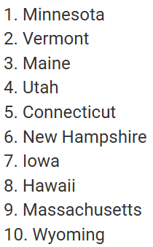
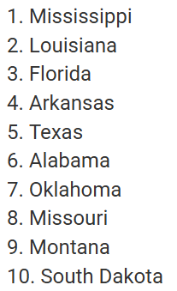
Part 4: Inclusion of Expert Opinion
Step 3: Information of Interest
Safe vs Dangerous
Goal: Scrape this Information into Vectors in R to Create a Table

Slide 19
Part 4: Inclusion of Expert Opinion
Step 4: Identifying CSS Selector
Go to Web Page
Choose SelectorGadget in Bookmark Tab
Locate This Box

Slide 20
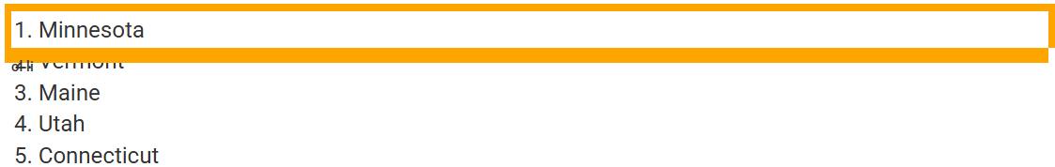
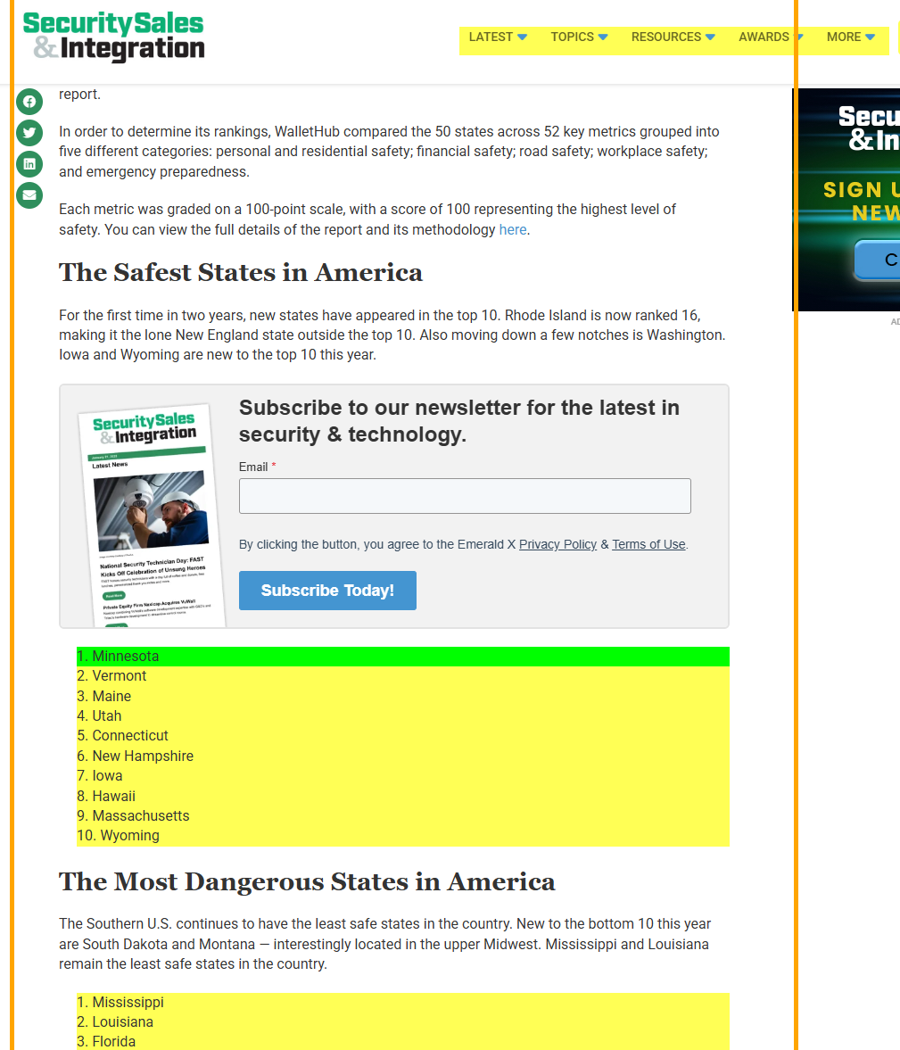
Part 4: Inclusion of Expert Opinion
Step 4: Continued
Find Content You Want
Point and Click
to Select Info
Info We Want is
Highlighted
Info We Don’t
Want, As Well
Hover Over Text We Want

Slide 21
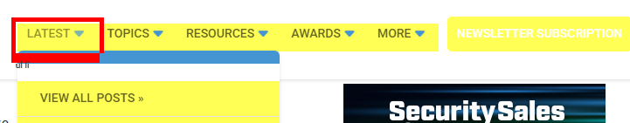
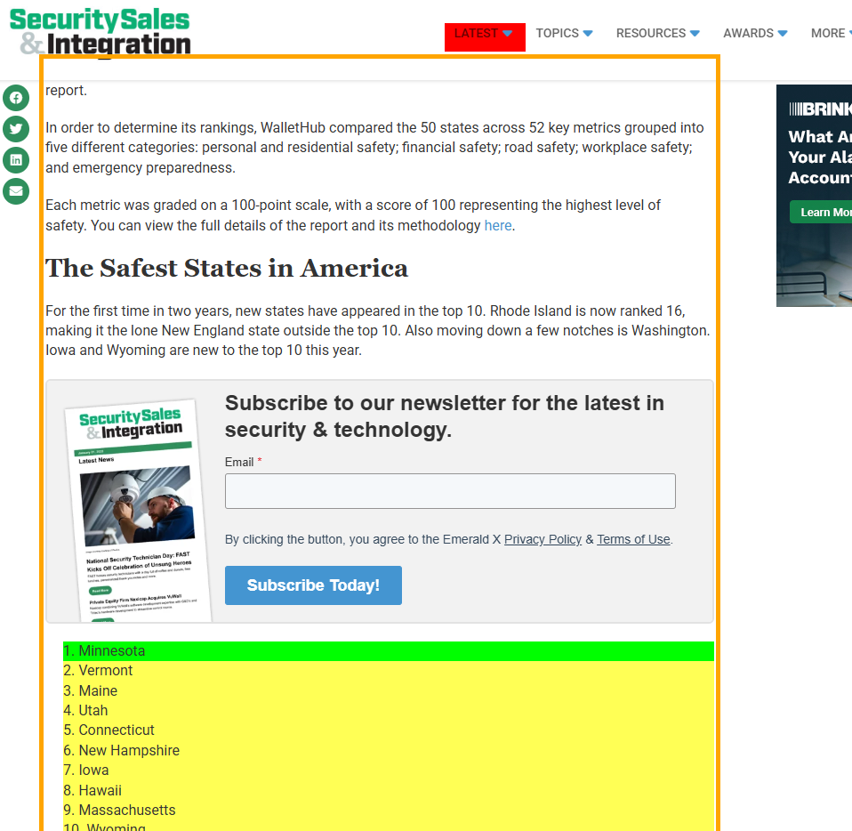
Part 4: Inclusion of Expert Opinion
Step 4: Continued
Find Content You Don’t Want
Point and Click
to Deselect
Hover Over Text We Don’t Want

Slide 22
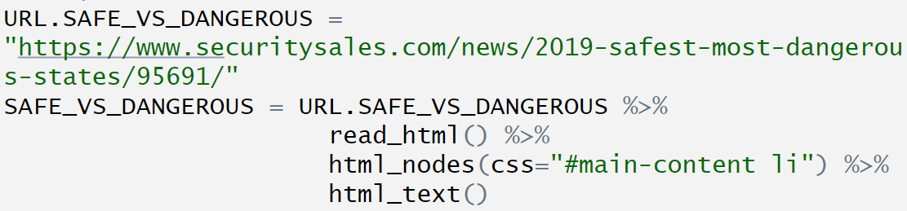
Part 4: Inclusion of Expert Opinion
Step 4: Continued
Relocate This Box
Copy CSS Selector
“#main-content li”
Step 5: Run Chunk 1
Step 6: Run Chunk 2
What About the Other States?
Step 7: Walk-off Knit

Slide 23
Closing
Disperse and Make Reasonable Decisions

